Slide 1
CSOC – Certification Structure Oversight Committee
Application Guidance
October 2015

Slide 2
Guidance
This guidance was developed in order to support a better understanding of the complex certification structure CSOC application process.
Please refer to referenced standards for all applicable requirements.

Slide 3
Guidance
Included in this guidance is information related to:
  Complex Certification Structure Criteria & Guidance
  CSOC Process Flow
  CB and AB application responsibilities
  Application forms
  Lessons learned
  Resources

Slide 4
Criteria
9104-001:2012
3.11 Certification Structure
  A term utilized to describe how the certification activities of an aviation, space, and defense organization will be structured and managed by the contracted CB. The defined structure will assist CBs with the development of a robust and conforming audit program, and provide industry with visibility of the structure within the OASIS database. These structures are defined below; further description is provided in Appendix B.
  e. Complex – An organization having an identified central function (the central office, but not necessarily the headquarters of the organization) at which certain activities are planned, controlled, or managed and a network of locations that are any combination of multiple site, campus, several sites, or more than one campus.

Slide 5
Criteria
9104-001:2012
8.1.3 Certification Structure Review and Determination
  The CB shall maintain documented evidence of the review and determination of all certification structures, including the audit duration calculation. For a complex certification structure, this information shall be forwarded to the IAQG OPMT Certification Oversight Subcommittee for review, prior to the Stage 2 audit.
8.2.1.5 Complex Certification Structure
    a. The for each organizational type subset shall be calculated using the applicable methodology for the certification structure (i.e., multiple site, campus, several sites). Complex organizations may also include organizations that contain more than one campus.
    The rational for the subset organizational types shall be documented by the client and the CB, and in all cases the applied methodology, audit duration calculation, planned audit program, sampling plan for multiple site organizations, processes for campus organizations, and associated justification shall be submitted for review to the IAQG OPMT Certification Structure Review Sub-audit duration Team.

Slide 6
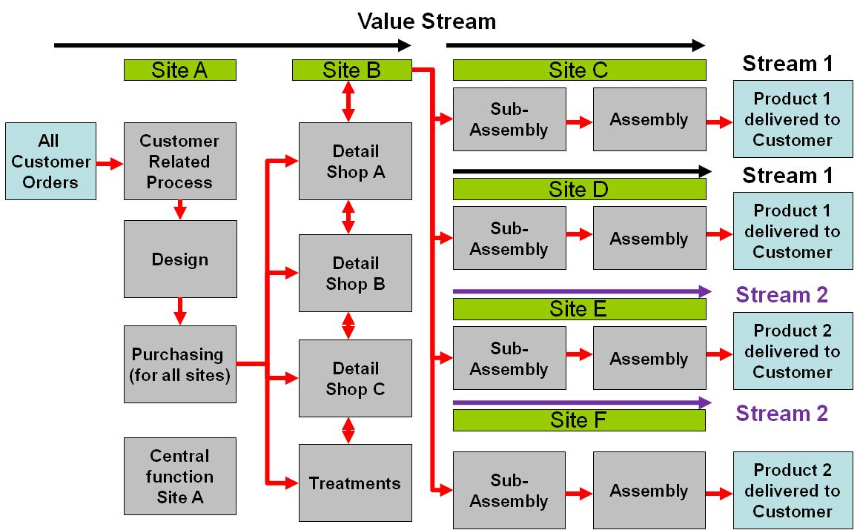
Certification Structures: Complex
9104-001
Guidance
An organisation having an identified central function (the central office, but not necessarily the headquarters of the organization) at which certain activities are planned, controlled, or managed
A network of locations that are any combination of multiple site, campus, several sites, or more than one campus
Example Diagram

Slide 7
Certification Structures: Complex
9104-001
Guidance
When a CB determines with its client that the certification structure will be ‘Complex’ they have to (clause 8.2.1.5):
  Document the rational for the subset organisational types
  An application is to be sent to the IAQG OPMT Certification Structure Oversight Committee (CSOC)
  The application includes:
    applied methodology,
    audit duration calculation,
    planned audit program and sampling plan for multiple site organizations, processes for campus organizations
    justification
Review results to be received from the IAQG OPMT CSOC before proceeding with the Stage 2 audit (clause 8.1.3)

Slide 8
Criteria
9104-001:2012
13.5 Certification Structure Oversight Subcommittee
  a. The IAQG OPMT will establish a subcommittee which shall have the responsibility to review and provide recommendations related to CB audit program proposals for complex certification structures.
  b. This subcommittee shall also be utilized by the OPMT to review any complaints received related to certification structure decisions.
  c. This review process shall be documented by the OPMT and will include requirements for sub-team representation (e.g., AB’s, CB’s, IAQG members), team member qualifications, and the timely management of CB requests.
  d. The results of these reviews and lessons learned will be reported to the OPMT.

Slide 9
Reference Information
CSOC Process:
This IAQG Other Party Management Team (OPMT) Operating Procedure 204 has been developed to define IAQG OPMT Certification Structure Oversight Committee (CSOC) requirements in support of conformance to the 9104-001 standard. This committee shall support certification structure complaint resolution and the review of complex certification structure requests.
Note: IAQG Operating procedures are not available to the general public; therefore we have provided reference to applicable information to support better awareness and understanding of the process.
Process guidance and request forms can be obtained via the OASIS database and CSOC guidance link (see slide 15).
CSOC Structure:
The CSOC is a committee comprised of representatives from all three IAQG global SMS (AAQG RMC, APAQG JRMC, EAQG OPMT), which is responsible for execution of the processes as described in this procedure and Appendix A process map.

Slide 10
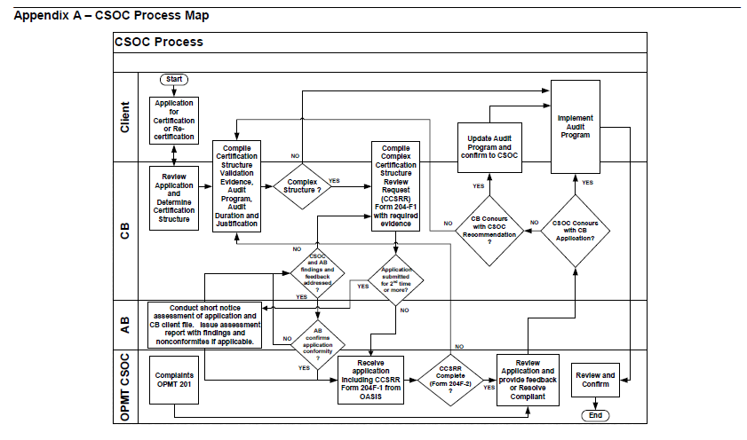
CSOC Process Flow
Reference: IAQG OPMT Procedure 204
Revision Letter: E
Date of Issue: 22-MAY-2014

Slide 11
CB CSOC Request Responsibilities
The CB requestor shall:
Obtain client concurrence with request prior to submittal.
Upload a completed Appendix B Request, Form 204F-1, along with supporting evidence to the AB CSOC OASIS feedback function for each new or transferred complex certification structure client application
  Note1: Appendix C, Form 204F-2, may be used by CB Requestor to ensure application is complete prior to submittal.
Provide a copy of all application submissions to their respective AB.
Review and determine actions to be taken based on CSOC recommendations
Notify clients of any certification structure or audit duration changes
Provide notification via the AB-CSOC OASIS feedback function, if CSOC recommendations are incorporated
Provide notification and justification, via the AB-CSOC OASIS feedback function, if CSOC recommendations are not incorporated
Confirm with their AB that any items, concerns or feedback raised by the first CSOC review are adequately addressed prior to the second or subsequent submittal of an application to the CSOC.
Submit an updated Appendix B, Form 204F-1, request via the AB-CSOC OASIS feedback function prior to each recertification cycle. This may be a copy of the previous Appendix B approved request form and a declaration of no change, in lieu of a new Appendix B request form.
  Respond to any OASIS feedback raised by the CSOC, where a response is requested, within 30 calendar days.

Slide 12
AB CSOC Request Responsibilities
The AB that has accredited a CB requesting CSOC approval of a complex certification structure application shall:
  Respond to any feedback raised by the CSOC, where a response is requested, within 30 calendar days.
  Confirm that items, concerns or other feedback raised by the first CSOC review are adequately addressed by the CB prior to the second or any subsequent submittal of an application to the CSOC.
  The CB and AB responsibilities in this guidance material relate to the initial application. The CSOC will request additional CB and AB actions should the application be cancelled or returned to the CB on more than two occasions.

Slide 13
Embedded - csoc Forms
Appendix B - Complex Certification Structure Review Request, Form 204F-1
&
Appendix C - CSOC Administrative Application Review, Form 204F-2
204F-2

Slide 14
CSOC - Lessons Learned
The following are some of the key themes from recent applications:
  Product descriptions are either too long or too short. Need to be clear and concise.
  Value stream maps are vague in some cases – difficult to understand or with missing sites
  Many basic errors are being made in core 9104-001 requirements
    Examples include: missing sites, rounding errors, incorrect audit day calculation for the sub-structure.
  No justification provided for a change in the certification structure i.e. from another certification structure
  Existing OASIS entry and CB application do not align
    Examples includes more than one OASIS certification entry for all the sites under the certification despite having the same certificate number
  Site additions to the structure have occurred mid-cycle
    CSOC does not need to review but needs to see what has changed at the 3-year re-submission.
  ISO 17021 requires justification of all audit durations
    examples include: a significant increase of on-site audit duration and no on-site audit duration additions without a documented justification
  The central function (as per 9104-001) is not the same as centralized processes such as purchasing.
  Where ‘new’ sites have been introduced to the certification ‘recertification’ audit duration has been proposed instead of the required ‘initial’ audit duration.

Slide 15
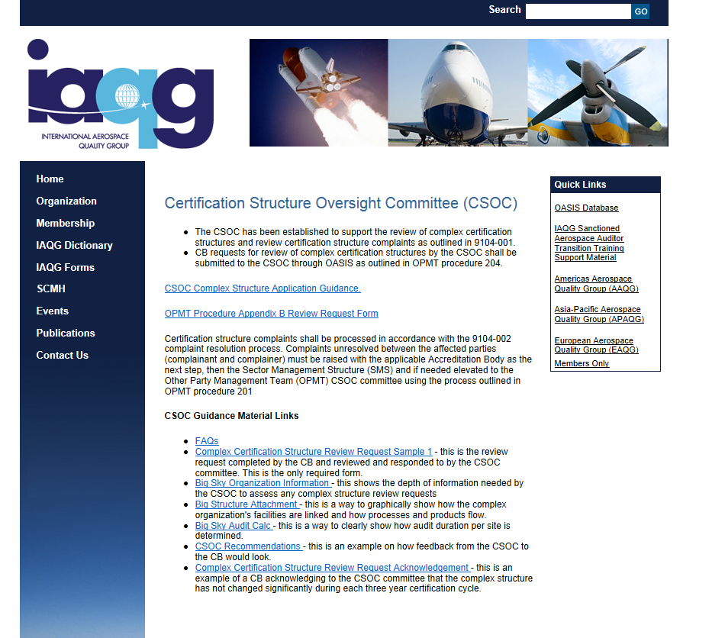
Resources IAQG – CSOC Web Page
http://www.sae.org/iaqg/organization/csoc.htm

Slide 16
Resources
We encourage our stakeholders to utilize the OASIS feedback functionality should additional clarification be needed.
  The OASIS feedback function includes the ability to ask the Sector Management Structure Chairs or the 9104-001 Sector Document Representatives (SDRs) questions regarding the intent of the published standard or CSOC expectations.
    Note: No consulting nor arbitration questions.

Slide 17
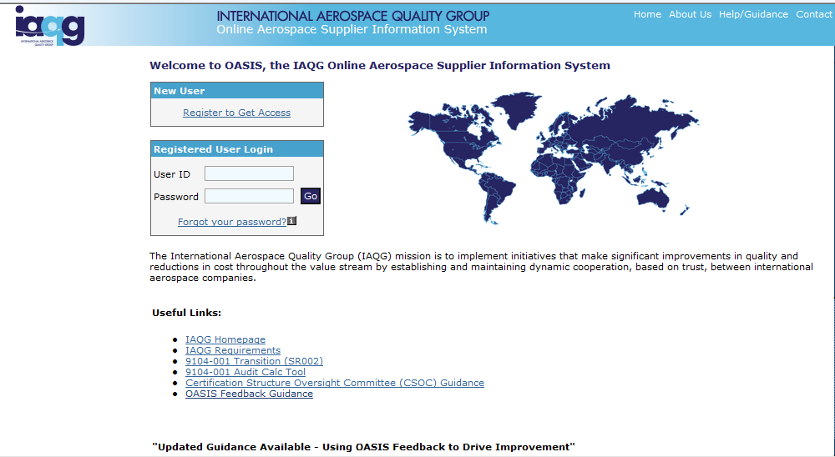
OASIS Feedback
Please utilize the attached link below and review the OASIS Feedback guidance demonstration.
OASIS Feedback Guidance

Slide 18
Thank you!
Stakeholders are encouraged to download this information and share it with their staff and clients that may be applying for complex certification structure.
ICOP Certification Scheme: Efficient - Recognized – Measurable Benefits

